Slide 2
Create Your First CI/CD Pipeline On Kubernetes With Jenkins
Peeyush Gupta

Slide 3

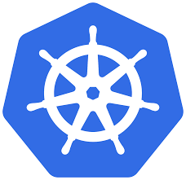


Who am I?
Peeyush Gupta
Sr. Developer Advocate @ DigitalOcean
#sig-contribex (@pensu91)
@pensu91
pgupta@digitalocean.com

Slide 4
Agenda
DevOps
CI/CD
Why Kubernetes
Demo
Q & A

Slide 5
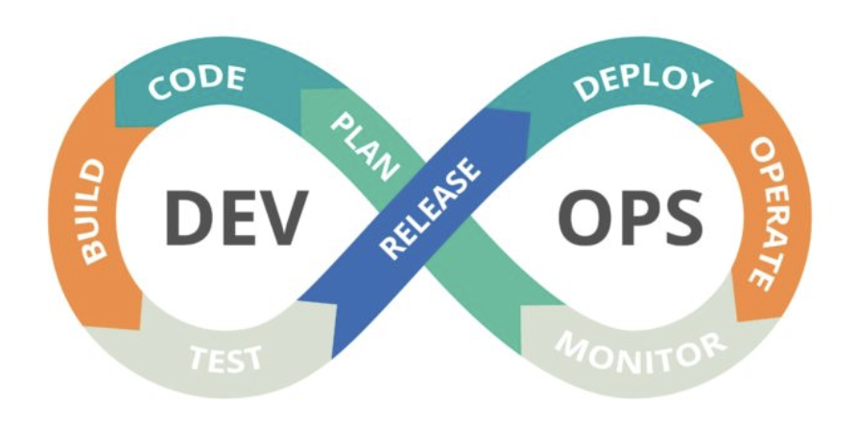
DevOps

Slide 6
Why DevOps ?
Increase productivity and profitability
Faster software lifecycle
Shorter time-to-market
Early detection and faster correction of defects
Notes:
company whose success is contingent on its ability to offer products to its online customers faster than competitors.
Adopting DevOps philosophy require a new mindset, tools, and skills. DevOps integrates developers and operations teams in order to improve collaboration and productivity by automating infrastructure, workflow, and continuously measuring application performance.

Slide 7
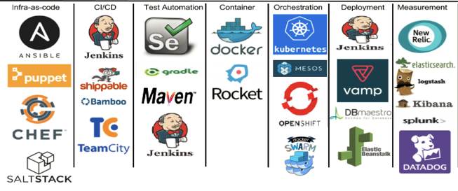
DevOps Tools
Notes:
Mostly used tools. Explain few of them

Slide 8
Continuous Integration (CI)
“CI is a practice of regularly merging the working copy of the code with mainline code”
CI tools:
Jenkins
Travis CI
Concourse

Slide 9
Continuous Deployment/Delivery (CD)
“CD is the mechanism to deploy application in production, after it meets the well defined criteria, like passing all the test cases.”
CD tools:
Jenkins
Spinnaker
Argo

Slide 10

Jenkins
Leading open source automation server
Started in 2004 at Sun as Hudson by Kohsuke Kawaguchi
Supports hundreds of plugins to make developers’ life easier.
Integration with leading cloud providers and SCMs.

Slide 11
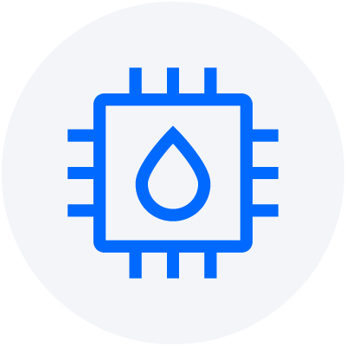

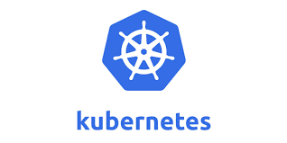

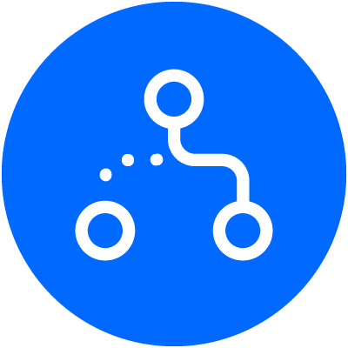

Let’s talk K8s!
Resource Efficient
Increases Productivity
Scalability
High Availability
Declarative API

Slide 12
DEMO

Slide 13
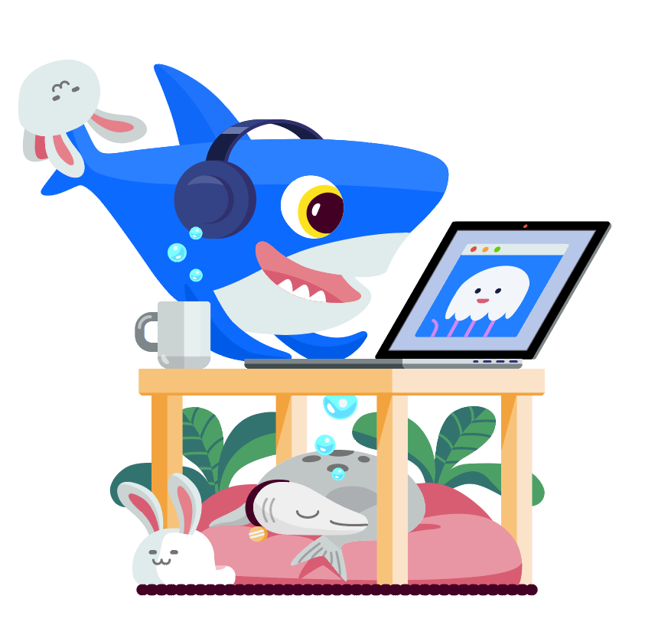



Thank You & Get in Touch!
LinkedIn: https://www.linkedin.com/in/peeyush-gupta-5a304250/
Twitter: https://twitter.com/pensu91
Email: pgupta@digitalocean.com
Try DigitalOcean - SIGN UP for FREE $100 CREDITS https://do.co/Peeyush

